Slide 1

LIP INGREDIENTS INFOGRAPHIC
Pigments | Structuring Agents | Emollients | Sensory | Actives | SPF

Slide 2
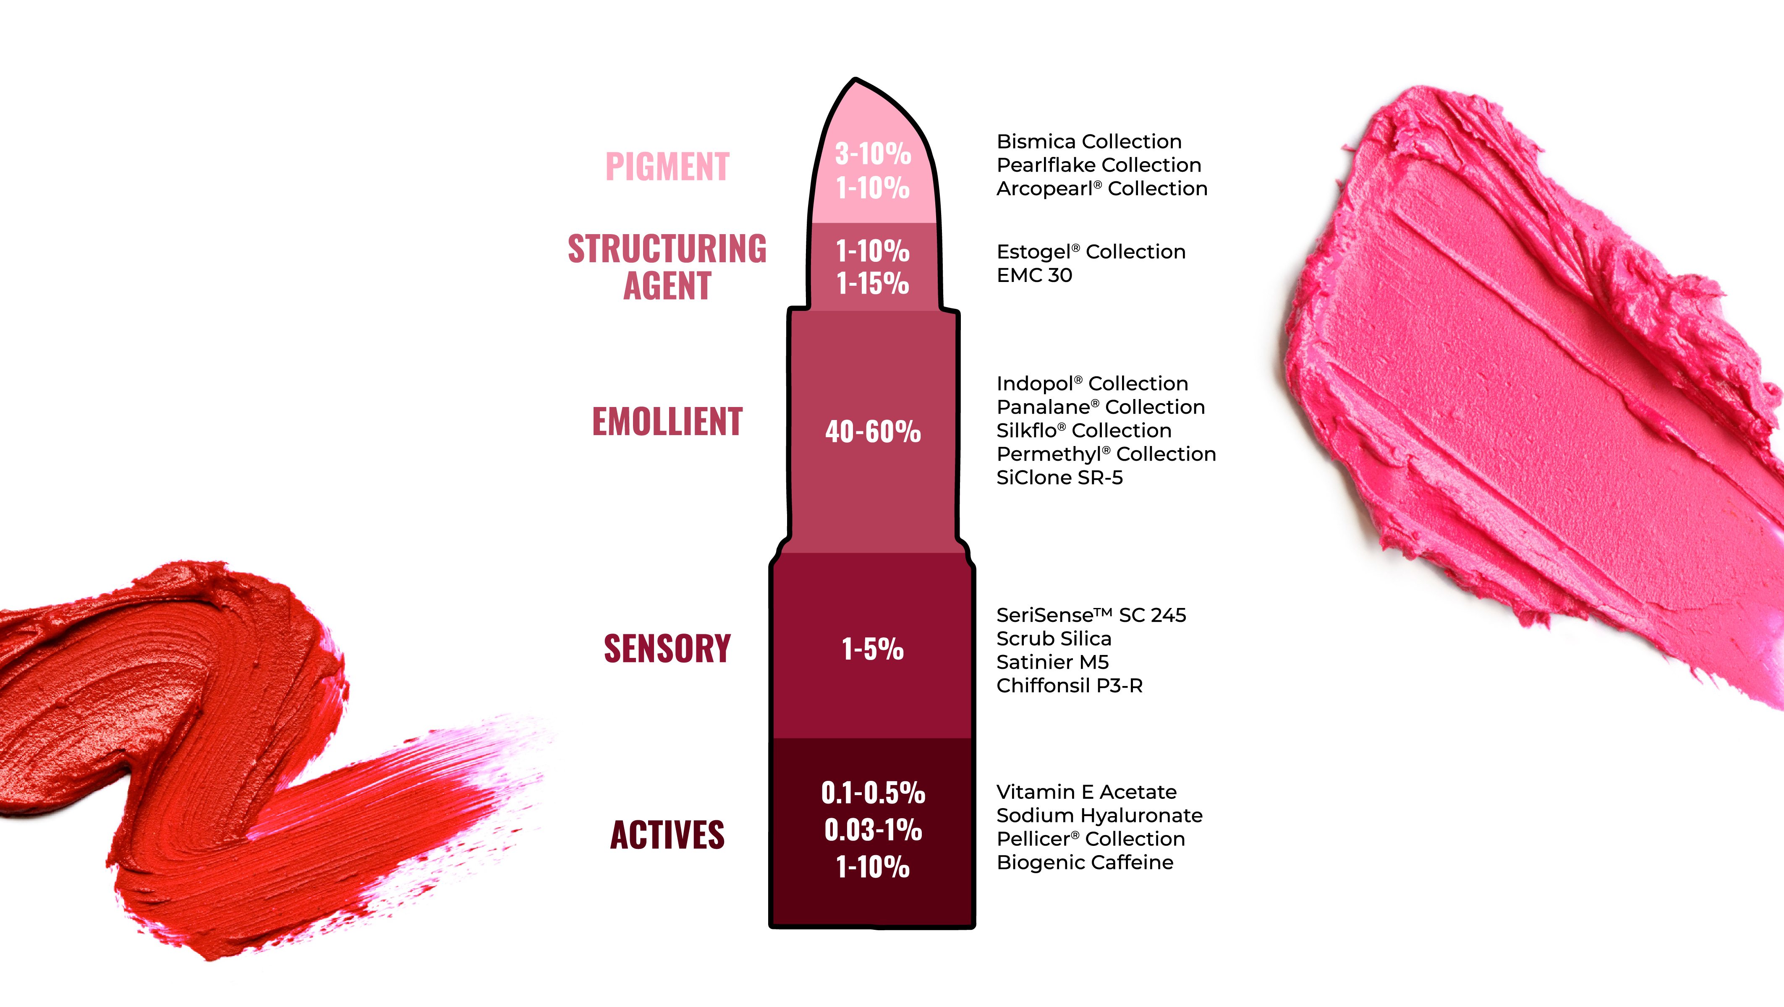
INGREDIENT COMPOSITION

Slide 3
INGREDIENT | DESCRIPTION | INCI | USE LEVEL | DISPERSIBILITY (OIL OR WATER) | FORMULATION GUIDELINES
Arcopearl® FEHD | Synthetic mica-based interference pigments | Synthetic Fluorphlogopite (and) Titanium Dioxide (and) Iron Oxides (and) Tin Oxide | 1-30% | Oil and Water | Higher levels can be used to achieve desired color effects. Can be formulated into powder, stick, gel and emulsion formulations. Add at end of processing. Do not homogenize. No known incompatibilities. Not sensitive to pH, temperature.
Arcopearl® Sparkle | Synthetic mica-based interference pigments | Synthetic Fluorphlogopite (and) Titanium Dioxide (and) Iron Oxides * (and) Tin Oxide | 1-30% | Oil and Water | Higher levels can be used to achieve desired color effects. Can be formulated into powder, stick, gel, and emulsion formulations. Add at the end of processing. Do not homogenize. No known incompatibilities. Not sensitive to pH, temperature.
Arcopearl® Pure | Natural mica substrate interference pigments finely coated in metallic oxide | Mica (and) Titanium Dioxide * (and) Iron Oxides* (and) Tin Oxide | 1-30% | Oil and Water | Higher levels can be used to achieve desired color effects. Can be formulated into powder, stick, gel and emulsion formulations. Add at end of processing. Do not homogenize. No known incompatibilities. Not sensitive to pH, temperature.
BisMica Collection | Pearl pigments uniquely bonded combination of bismuth oxychloride, pigments, and mica | Bismuth Oxychloride (and) Mica (and) Pigment* (and) Stearate** (Calcium or Magnesium) | 1-25% | Oil | Higher levels can be used to achieve desired color effects. Not for aqueous products such as gels, cleansers. Add at the end of the batch. Not sensitive to temperature. Potential pH sensitivity based on pigment grade.
BisMica MAX Collection | "High octane" pigments with a high colorant load (~70%) and easy dispersibility | Pigment* (and) Bismuth Oxychloride (and) Mica | 1-25% | Oil | Higher levels can be used to achieve desired color effects. Not for aqueous products such as gels, cleansers. Add at the end of the batch. Not sensitive to temperature. Potential pH sensitivity based on pigment grade.
Pearlflake Collection | Bismuth Oxychloride and pigments in wax based pellets | Bismuth Oxychloride (and) Pigment (and) Isododecane (and) Copernicia Cerifera (Carnauba) Wax (and) Butyrospermum Parkii (Shea) Butter | 1-20% | Oil | Higher levels can be used to achieve desired color effects. Not for aqueous products such as gels, cleansers. Heat batch to 75-85°C prior to addition. Add at the end of the batch. No homogenization required, prop mixing is sufficient. In emulsions, add to oil phase.
Bismuth Oxychloride Pearl Collection | Pearl pigments that have excellent adhesion | Bismuth Oxychloride UCR grades: Bismuth Oxychloride (and) Zinc Oxide | 1-75% | Oil | Appropriate use for eye or lip area. Applications should be confirmed against current regulations. Not sensitive to temperature.
PIGMENTS

Slide 4
INGREDIENT | DESCRIPTION | INCI | USE LEVEL | DISPERSIBILITY (OIL OR WATER) | FORMULATION GUIDELINES
EstoGel® M | Biobased high performance polymer that allows formulators to have better control over the desired rheology | Castor Oil/IPDI Copolymer (and) Caprylic/Capric Triglyceride | 1-30% | Oil | Introduce EstoGel® M into the oil phase and heat to 100°C with stirring. Once EstoGel® M is dissolved, ensure a perfect dispersion of the polymer by stirring for 30 minutes. Cool down to room temperature. The gel needs several hours to reach the optimum viscosity.
EstoGel® Green | 100% natural gelling agent that combines naturalness with performance to meet the challenges of tomorrow | Hydrogenated Castor Oil/Sebacic Acid Copolymer | 0.5-6% | Oil | Introduce EstoGel® Green into the oil phase and heat to 80°C with constant stirring. Once the polymer is dissolved, ensure a good dispersion by stirring for 20 minutes. The gel needs several hours to reach the optimum viscosity.
EMC30 | Structuring agent that creates flexible gels | Caprylic/Capric Triglyceride (and) Castor Oil/IPDI Copolymer | 3-90% | Oil | Introduce EMC30 into the oil phase and heat to 80°C with constant stirring. Once the polymer is dissolved, ensure a good dispersion by stirring for 30 minutes. The gel needs several hours to reach the final viscosity.
EstoGel® Max | EstoGel Max is an oil rheology modifier used to optimize stability and texture of oily gel structures | Castor Oil /IPDI Copolymer (and) Caprylic Capric Triglyceride (and) Hydrogenated Castor Oil/Sebacic Acid Copolymer | 0.5-50% | Oil | Can be used in O/W or W/O systems. Can be used for anhydrous serums or body oils, anhydrous sticks. In aqueous systems, can be used over a wide pH range. Add to oil phase, heat to minimum 85°C and mix with a rotor stator for 30 minutes. If a less shear-intense process is used, increase the temperature of mixing. Check for homogeneity, then cool to room temperature under continued stirring. Gel will be fully developed at room temperature after several hours.
Aqupec® Collection | Excellent rheology modifiers with several different thickening efficiencies or options for texture modifications | Aqupec® HV-801EG-300, HV-805EG-300: Carbomer Aqupec® MG N40R: Sodium Carbomer Aqupec® HV-701EDR, HV-803ERK, SER W-300C, SW-705ER: Acrylates/C10-30 Alkyl Acrylate Crosspolymer | 0.1-1% | Water | Add slowly to water phase to avoid clumping. Use of dispersion blade recommended. Use caution when homogenizing as it can reduce viscosity. Formulation pH range: 5-10
ExpertGel® EG412 | Thermosensitive polymers designed for aqueous phase rheology modification | Poloxamer 407 (and) PPG-12/SMDI Copolymer | 1-7.5% | Water | ExpertGel® EG412 undergoes gelation at a lower temperature. Add ExpertGel® into the oil phase, heat up to 70ºC minimum until the ExpertGel® is solubilized into the oil phase creating the emulsion. The polymer will migrate to the water phase during the emulsification process.
STRUCTURING AGENT

Slide 5
INGREDIENT | DESCRIPTION | INCI | USE LEVEL | DISPERSIBILITY (OIL OR WATER) | FORMULATION GUIDELINES
GreenDiol® | Naturally derived multi-functional humectant | 2,3-Butanediol (and) Water | 1-10% | Water | Add to water phase. Can be used in various product forms: Emulsions, Cleansers, Serums, and Fragrances
Indopol® Collection | Film forming medium-high viscosity emollient | Polybutene | 1-70% | Oil | Suitable for use in different product forms: Emulsions, Anhydrous Formulations, Sticks and Powders. Can be used as the sole oil phase of an emulsion or in combination with other emollients.
Panalane® Collection | Emollients that are designed to improve wear resistance properties and skin hydration | Hydrogenated Polyisobutene | 1-70% | Oil | Suitable for use in different product forms: Emulsions, Anhydrous Formulations, Sticks and Powders. Can be used as the sole oil phase of an emulsion or in combination with other emollients.
Silkflo® Collection | A series of hydrogenated oligomers of 1-decene, that are high purity | Silkflo® 362: Hydrogenated Didecene​ Silkflo® 364, 366: Hydrogenated Polydecene | 1-70% | Oil | Suitable for use in different product forms: Emulsions, Anhydrous Formulations, Sticks and Powders. Can be used as the sole oil phase of an emulsion or in combination with other emollients.
Permethyl® 99A | Emollient and film former that provides excellent solvency with a light feel | Isohexadecane | 1-70% | Oil | Suitable for use in different product forms: Emulsions, Anhydrous Formulations, Sticks and Powders. Can be used as the sole oil phase of an emulsion or in combination with other emollients. In pressed powder formulations, it can be incorporated as a binder.
Permethyl® 101A | Emollient and film former that enhances spreadability and moisturization | Isohexadecane | 1-70% | Oil | Suitable for use in different product forms: Emulsions, Anhydrous Formulations, Sticks and Powders. Can be used as the sole oil phase of an emulsion or in combination with other emollients. In pressed powder formulations, it can be incorporated as a binder.
Permethyl® 102A | Emollient and film former that provides high sheen and luster without oil | Isoeicosane | 1-70% | Oil | Suitable for use in different product forms: Emulsions, Anhydrous Formulations, Sticks and Powders. Can be used as the sole oil phase of an emulsion or in combination with other emollients. In pressed powder formulations, it can be incorporated as a binder.
SiClone® SR-5 | Hydrocarbon based Silicone replacement | Isohexadecane (and) Isododecane (and) C13-15 Alkane | 1-70% | Oil | Suitable for use in anhydrous formulations. . In pressed powder formulations, it can be incorporated as a binder. Can be used as the sole oil phase of an emulsion or in combination with other emollients.
EMOLLIENTS

Slide 6
INGREDIENT | DESCRIPTION | INCI | USE LEVEL | DISPERSIBILITY (OIL OR WATER) | FORMULATION GUIDELINES
SeriSense™ SC 245 | Natural and biodegradable alternative to Nylon-12, PMMA and plastic scrub beads | Microcrystalline Cellulose | 1-5% | Water | Can be used in different product forms: gels, sticks, gel cleansers, creams, cream cleansers, and combined with chemical exfoliators. Add at the end of the batch and mix slowly. Formulation should be able to suspend particles.
Spheron Collection | Silica microbeads with high oil absorption | Spheron L-1500, P-1500, LP-230, P-4000, 20MB, EP-MMS: Silica Spheron P1500-030: Silica (and) Methicone | 1-10% | Oil and Water | Can be added to the oil or water phase. Can be used in different product forms, sticks, powders and emulsions, etc.
Luxsil® AL Free | Hollow microsphere that provides a light, powdery feel for detackifying purposes and is aluminum free | Calcium Sodium Borosilicate | 1-10% | Water | Can be added prior to or after emulsification. Can be added to the oil or the water phase. Can be used in different product forms, sticks, powders, emulsions, etc. Not heat sensitive. Not shear sensitive
Chiffonsil P-3R | High grade silica with low oil absorption, providing a smooth finish with a creamy texture | Silica | 1-10% | Oil and Water | Can be added to the oil or water phase. Can be used in different product forms, sticks, powders and emulsions, etc. May lower pH when added to water, when making a gel disperse powder before neutralizing.
Seriluxe™ TRIP | Talc-free proprietary blend designed to provide excellent compressibility with aesthetically pleasing sensorial attributes | Mica (and) Bismuth Oxychloride (and) Calcium Sodium Borosilicate | 1-75% | Oil | Not sensitive to temperature. Not sensitive to pH. No known incompatibilities.
Sericite Collection | Talc alternative powders that is a functional bulk filler and texture enhancer | Sericite FSE, PHN, SL: Mica Sericite SL-012: Mica (and) Methicone | 1-75% | Oil | Primarily used in pressed and loose powders but can be used in anhydrous systems, as well as emulsions at low levels.Not intended for use as a colorant.
Satinier M5 | A silica grade that has a smooth particle surface and provides moderate oil absorption, allowing for an elegant texture | Silica | 1-5% | Oil and Water | Can be added to the oil or water phase. Can be used in different product forms, sticks, powders, emulsions, etc.
Scrub Silica 180G | A natural origin exfoliating material that is an alternative to plastic beads | Silica | 1-5% | Water | Optimal pH range: 3-9. In emulsions, add after forming the emulsion. Should not be homogenized. Can alter pH when added to water.
Scrub Silica 300G | A natural origin exfoliating material that is an alternative to plastic beads | Silica | 1-5% | Water | Optimal pH range: 3-9. In emulsions, add after forming the emulsion. Should not be homogenized. Can alter pH when added to water.
Scrub Silica 600G | A natural origin exfoliating material that is an alternative to plastic beads | Silica | 1-5% | Water | Optimal pH range: 3-9. In emulsions, add after forming the emulsion. Should not be homogenized. Can alter pH when added to water.
Scrub Silica 40S | A natural origin exfoliating material that is an alternative to plastic beads | Silica | 1-5% | Water | Optimal pH range: 3-9. In emulsions, add after forming the emulsion. Should not be homogenized. Can alter pH when added to water.
Anybes Nylon-12 | A white spherical powder that has an ultra-soft feel with excellent skin adhesion | Nylon-12 | 1-10% | Oil | Can be used in different product forms; powders, sticks, emulsions. No restrictions on processing.
SENSORY

Slide 7
INGREDIENT | DESCRIPTION | INCI | USE LEVEL | DISPERSIBILITY (OIL OR WATER) | FORMULATION GUIDELINES
Sodium Hyaluronate High MW 1.8-2.2 MDa | Sodium Hyaluronate is the sodium salt of hyaluronic acid (HA) | Sodium Hyaluronate | 0.1-0.5% | Water | Suggested final formulation pH: 5-7. Add to water phase or post add. Ensure it is completely solubilized before continuing the formula. Not recommended for use in anhydrous product.
Sodium Hyaluronate Medium MW 1.2-1.5 MDa
Sodium Hyaluronate Low MW 0.2-0.4 MDa
Sodium Hyaluronate Very Low MW < 10 kDa
Vitamin E | Vitamin E (all-rac-α-Tocopheryl Acetate) is a more stable form of Vitamin E (Tocopherol) | Tocopheryl Acetate | 0.3-5% | Oil | Recommended pH range: 4-8. Add to oil phase. Sensitive to heavy metals.
Pellicer® L-30 | A multifunctional active composed of naturally derived fatty acids and peptides | Pellicer® L-30: Water (and) Sodium Dilauramidoglutamide Lysine Pellicer® LB-30G, LB-10: Water (and) Sodium Dilauramidoglutamide Lysine (and) Butylene Glycol | 0.03-1% | Water | Add to water phase. Cold or hot process. Apply high shear for ~5-7 minutes. Recommended pH for emulsification: 4-10.
Pellicer® LB-30G
Pellicer® LB-10
BioGenic Caffeine-210-WS | Encapsulated and stabilized form of caffeine, which enables the use of high concentrations of caffeine in aqueous formulations | Caffeine (and) Maltodextrin (and) Xanthan Gum (and) Hydroxyethylcellulose (and) Salicylic Acid (and) Phenoxyethanol | 1-10% | Water | Suggested final formulation pH: 3.5-8.5. Add to water phase prior to emulsification. Use of carbomer thickener not recommended. No sensitivity to homogenizer or high agitation mixing. Ensure it is completely solubilized before continuing the formula. When using a polymer to thicken, dissolve the caffeine prior to adding polymer. This product may contribute to overall salts in the system. Not recommended for use in anhydrous products.
ACTIVES

Slide 8
INGREDIENT | DESCRIPTION | INCI | USE LEVEL | DISPERSIBILITY (OIL OR WATER) | FORMULATION GUIDELINES
MZX-304OTS | GMP grade, broad spectrum UV filter that offer superior transparency | Zinc Oxide (and) Triethoxycaprylylsilane | 1-25% | Oil | Keep pH above 7.5. Add to oil phase. Use of a chelating agent is necessary. Recommended to thicken with gums. Use nonionic or cationic emulsifiers. Homogenization required. Refer to local regulatory guidelines regarding maximum use level. In U.S., maximum use level of ZnO in sunscreen OTC products is 25%.
MT-N1 | GMP grade, rutile, micronized Titanium Dioxide surface treated with Stearic Acid and Aluminum Hydroxide | Titanium Dioxide (and) Stearic Acid (and) Aluminum Hydroxide | 1-25% | Oil | Add to oil phase. Homogenization required. Refer to local regulatory guidelines regarding maximum use level. In U.S., maximum use level of TiO2 in sunscreen OTC products is 25%. In U.S., TiO2 cannot be used together with avobenzone.
MZ-500 | GMP grade, non-coated, micronized zinc oxide with excellent SPF efficacy and transparency | Zinc Oxide | 1-25% | Oil | Keep pH above 7.5. Can be added to oil or water phase. Use of a chelating agent is necessary. Recommended to thicken with gums. Use nonionic or cationic emulsifiers. Homogenization required. Refer to local regulatory guidelines regarding maximum use level. In U.S., maximum use level of ZnO in sunscreen OTC products is 25%.
SPF

